Slide 1

Module 2
APPLIACTION LAYER

Slide 2
Module 2 : Application layer
our goals:
conceptual, implementation aspects of network application protocols
  transport-layer service models
  client-server paradigm
  peer-to-peer paradigm
learn about protocols by examining popular application-level protocols
  HTTP
  FTP
  SMTP / POP3 / IMAP
  DNS

Slide 3
Some network apps
e-mail
web
text messaging
remote login
P2P file sharing
multi-user network games
streaming stored video (YouTube, Hulu, Netflix)
voice over IP (e.g., Skype)
real-time video conferencing
social networking

Slide 4

















Creating a network app
application
transport
network
data link
physical
write programs that:
run on (different) end systems
communicate over network
e.g.,In web application, web server software communicates with browser software
Can be written in C, JAVA or Python
no need to write software for network-core devices
network-core devices do not run user applications
applications on end systems allows for rapid app development, propagation
application
transport
network
data link
physical
application
transport
network
data link
physical

Slide 5
Application architectures
Network architecture is fixed.
The application architecture is designed by the application developer and dictates how the application is structured over various end systems.
possible structure of applications:
client-server architecture
peer-to-peer (P2P) architecture

Slide 6
Client-server architecture
server:
always-on host
permanent IP address
services all requests from many other hosts
data centers for scaling
clients:
communicate with server
may have dynamic IP addresses
do not communicate directly with each other
Ex: Web, FTP, Telnet, email etc
client/server

Slide 7
P2P architecture
no always-on server
arbitrary end systems directly communicate
peers request service from other peers, provide service in return to other peers
  self scalability – new peers bring new service capacity, as well as new service demands
peers are intermittently connected and change IP addresses
  complex management
peer-peer

Slide 8
Processes communicating
process: program running within a host
within same host, two processes communicate using inter-process communication (defined by OS)
processes in different hosts communicate by exchanging messages
clients, servers
client process: process that initiates communication
server process: process that waits to be contacted
Ex: browser is a client process, server is a server process
Peer that is downloading the file is client, peer that is uploading the file is server.

Slide 9

The Interface between Process and Computer Network
process sends/receives messages to/from its socket
socket analogous to door
  sending process shoves message out of the door
  sending process relies on transport infrastructure on other side of door to deliver message to socket at receiving process
application
socket
application
controlled by
app developer
process
process
transport
transport
network
network
controlled
by OS
link
Internet
link
physical
physical

Slide 10
Addressing processes
to receive messages, process must have identifier
host device has unique 32-bit IP address
Q: does IP address of host on which process runs sufficient for identifying the process?
identifier includes both IP address and port numbers associated with process on host.
example port numbers:
  HTTP server: 80
  mail server: 25
to send HTTP message to gaia.cs.umass.edu web server:
  IP address: 128.119.245.12
  port number: 80
  A: no, many processes can be running on same host

Slide 11
Port Numbers
Used to identify a specific process.
Ranges from 0 – 65,535
Restricted or well known ports ranges from 0 – 1023
Software companies can reserve port numbers from 1024 – 49151
Dynamic ports from 49152 – 65535 is available for anyone to use
  Ex: 20 & 21 – FTP
  25 – SMTP
  53 – DNS
  80 – HTTP
  443 - HTTPS

Slide 12
Transport Services Available to Applications
Four Services:
Reliable data transfer:
  Guarantees that the data sent by one end of application is delivered correctly and completely to the other end of the application.
  Loss tolerant applications : some of the data sent may never arrive (ex: multimedia)
Throughput:
  Rate at which the sending process can deliver bits to the receiving process
  Applications that have throughput requirements are called bandwidth-sensitive applications
  Applications could request a guaranteed throughput (ex: internet telephony)

Slide 13
Transport Services Available to Applications
Timing:
  Every bits that the sender pump into the socket arrives at the receiver’s socket in no more than 100ms
  Ex : Real time apps (internet telephony, teleconferencing, multiplayer games etc)
Security:
  Provides one or more security services
  Confidentiality, data integrity, end point authentication

Slide 14
Transport Services Provided by the Internet
Internet makes two transport protocols available to application:
TCP
  Connection oriented service (handshaking)
    Full duplex connection
    When application finishes sending messages, it must tear down the connection
  Reliable data transfer service
UDP
  Connectionless (no handshaking)
  Unreliable data transfer (no guarantee)

Slide 15
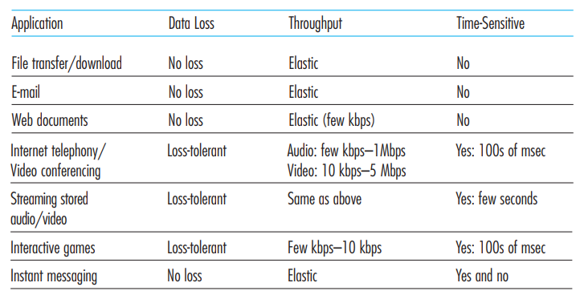
Requirements of selected network applications

Slide 16
Services not provided by the Internet Transport Protocols
Services not provides by today’s Internet Transport Protocols
  Throughput
  Timing guarantees
Time sensitive apps are designed to cope with this lack of guarantee
Today’s internet can provide satisfactory service to time sensitive applications, but no timing and throughput guarantees.

Slide 17
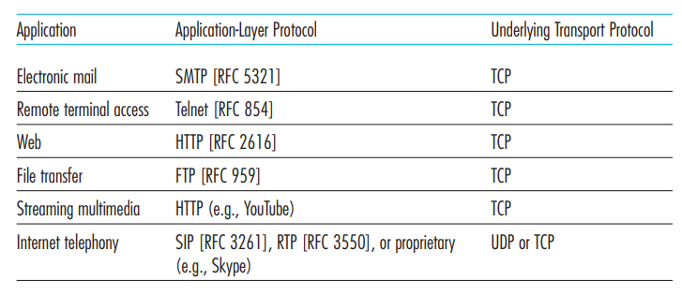
Internet Applications, their Application Layer Protocols and underlying Transport Protocols

Slide 18
Application Layer Protocols
Application layer protocol defines how an application’s process, running on different end systems, pass message to each other.
Application Layer Protocol defines:
  Types of messages exchanged
  Syntax of various message types (such as fields in the messages)
  Semantics of the fields (meaning of the information in the fields)
  Rules for determining when and how a process sends messages and responds to messages

Slide 19
Application Layer Protocols
Some application-layer protocols are specified in RFCs
The Web’s application-layer protocol, HTTP (the HyperText Transfer Protocol [RFC 2616]), is available as an RFC
The Web application consists of many components
  including a standard for document formats (that is, HTML),
  Web browsers (for example, Firefox and Microsoft Internet Explorer),
  Web servers (for example, Apache and Microsoft servers), and
  an application-layer protocol
HTTP defines the format and sequence of messages exchanged between browser and Web server
HTTP is one important piece of the Web application

Slide 20
Network Applications Covered
Five important applications:
  Web
  File transfer
  Electronic mail
  Directory service
  P2P application
Protocols associated with these applications:
  HTTP
  FTP
  SMTP, POP3,IMAP
  DNS
  Bit Torrent

Slide 21
Web and HTTP
HTTP is implemented in two programs : a client & a server program
HTTP defines the structure of these messages and how the client and server exchange the messages. (Defined in RFC 1945 and RFC 2616)
Web Terminologies:
web page consists of objects
object can be HTML file, JPEG image, Java applet, audio file- addressable by single URL
web page consists of base HTML-file which includes several referenced objects
each object is addressable by a URL, e.g.,
www.someschool.edu/someDept/pic.gif
host name
path name

Slide 22

HTTP overview
HTTP: hypertext transfer protocol
Defines how web clients request web pages and how servers transfer web pages to clients
Web’s application layer protocol
Uses TCP as underlying transport protocol
client/server model
  client: browser that requests, receives, (using HTTP protocol) and “displays” Web objects
  server: Web server sends (using HTTP protocol) objects in response to requests
HTTP request
PC running
Firefox browser
HTTP response
HTTP request
server
running
Apache Web
server
HTTP response
iphone running
Safari browser

Slide 23
HTTP overview (continued)
uses TCP:
client initiates TCP connection (creates socket) to server, port 80
server accepts TCP connection from client
HTTP messages (application-layer protocol messages) exchanged between browser (HTTP client) and Web server (HTTP server)
TCP connection closed
HTTP is “stateless”
server maintains no information about past client requests
protocols that maintain “state” are complex!
past history (state) must be maintained
if server/client crashes, their views of “state” may be inconsistent, must be reconciled

Slide 24
HTTP connections
persistent HTTP
All requests and their corresponding responses are sent over the same TCP connection
multiple objects can be sent over single TCP connection between client, server
non-persistent HTTP
Each request/response pair is sent over a separate TCP connection
at most one object sent over TCP connection
  connection then closed
downloading multiple objects required multiple connections

Slide 25
Non-persistent HTTP
(contains text,
references to 10
jpeg images)
suppose user enters URL:
www.someSchool.edu/someDepartment/home.index
1a. HTTP client initiates TCP connection to HTTP server (process) at www.someSchool.edu on port 80
1b. HTTP server at host www.someSchool.edu waiting for TCP connection at port 80. “accepts” connection, notifying client
2. HTTP client sends HTTP request message (containing URL) into TCP connection socket. Message indicates that client wants object someDepartment/home.index
3. HTTP server receives request message, forms response message containing requested object, and sends message into its socket
time

Slide 26
Non-persistent HTTP (cont.)
4. HTTP server closes TCP connection.
5. HTTP client receives response message containing html file, displays html. Parsing html file, finds 10 referenced jpeg objects
time
6. Steps 1-5 repeated for each of 10 jpeg objects

Slide 27
Non-persistent HTTP: response time
RTT (definition): time for a small packet to travel from client to server and back to the client
HTTP response time:
TCP uses a three-way handshake
one RTT to initiate TCP connection
one RTT for HTTP request and first few bytes of HTTP response to return
file transmission time
non-persistent HTTP response time =
  2RTT+ file transmission time
initiate TCP
connection
RTT
request
file
RTT
time to
transmit
file
file
received
time
time

Slide 28
Persistent HTTP
non-persistent HTTP issues:
requires 2 RTTs per object
browsers often open parallel TCP connections to fetch referenced objects
persistent HTTP:
server leaves connection open after sending response
subsequent HTTP messages between same client/server sent over open connection
client sends requests as soon as it encounters a referenced object
as little as one RTT for all the referenced objects
HTTP closes a connection when it isn’t used for a certain time

Slide 29
HTTP request message
two types of HTTP messages: request, response
HTTP request message:
  ASCII (human-readable format)
Request line has three fields:
  Method field
  URL field
  HTTP version field
request line
(GET, POST,
HEAD, PUT, DELETE)
GET /somedir/page.html HTTP/1.1
Host: www.someschool.edu
Connection: close
User-agent: Mozilla/5.0
Accept-language: fr
header
lines

Slide 30
HTTP request message: general format
method
sp
URL
sp
version
cr
lf
request
line
header field name
value
cr
lf
~
~
header
lines
~
~
header field name
value
cr
lf
cr
lf
Blank line
~
entity body
~
body
~
~

Slide 31
Uploading form input
POST method:
web page often includes form input
input is uploaded to server in entity body
URL method:
uses GET method
input is uploaded in URL field of request line:
www.somesite.com/animalsearch?monkeys&banana

Slide 32
Method types
HTTP/1.0:
GET
POST
HEAD
  asks server to leave requested object out of response
  Gives the status line
HTTP/1.1:
GET, POST, HEAD
PUT
  uploads file in entity body to path specified in URL field
DELETE
  deletes file specified in the URL field

Slide 33
HTTP response message
Three Sections:
  Initial status line
  Six header lines
  Entire body
status line
HTTP/1.1 200 OK
Connection: close
Date: Tue, 09 Aug 2011 15:44:04 GMT
Server: Apache/2.2.3 (CentOS)
Last-Modified: Tue, 09 Aug 2011 15:11:03 GMT
Content-Length: 6821
Content-Type: text/html
(data data data data . . . . )
header
lines
Status line has three fields:
  Protocol version field
  Status code
  Status message
data, e.g.,
requested
HTML file

Slide 34
HTTP response status codes
Status code with associated phrase indicates the result of the request
status code appears in 1st line in server-to-client response message
some sample codes:
200 OK
  request succeeded, requested object later in this msg
301 Moved Permanently
  requested object moved, new location specified later in this msg (Location:)
400 Bad Request
  request msg not understood by server
404 Not Found
  requested document not found on this server
505 HTTP Version Not Supported

Slide 35
User-server Interaction : Cookies
Cookies are defined in [RFC 6265], allow sites to keep track of users
four components:
  1) cookie header line in the HTTP response message
  2) cookie header line in the HTTP request message
  3) cookie file kept on user’s end system and managed by user’s browser
  4) back-end database at Web site
example:
Susan always access Internet from PC
visits specific e-commerce site for first time
when initial HTTP requests arrives at site, site creates:
  unique ID (identification number)
  entry in backend database for ID

Slide 36
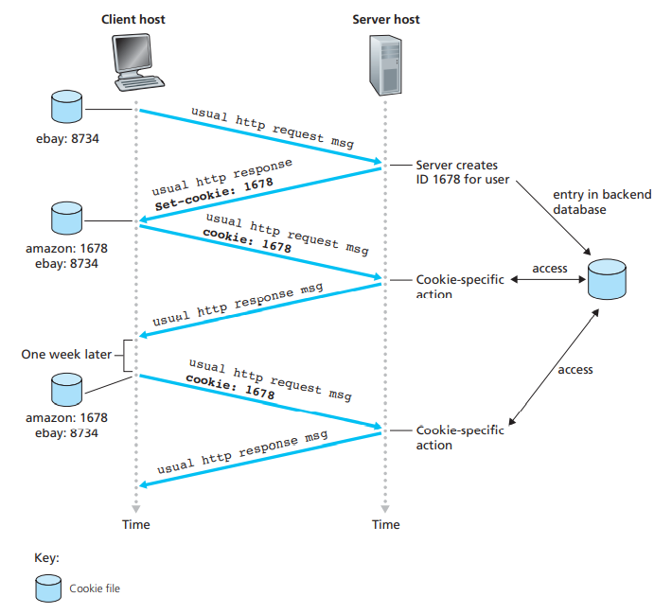
Keeping user state with cookies

Slide 37
Cookies (continued)
what cookies can be used for:
authorization
shopping carts
recommendations
user session state (Web e-mail)
cookies and privacy:
cookies permit sites to learn a lot about you
you may supply name and e-mail to sites
how to keep “state”:
protocol endpoints: maintain state at sender/receiver over multiple transactions
cookies: http messages carry state

Slide 38

Web caches (proxy server)
goal: satisfy client request without involving origin web server
user sets browser: Web accesses via cache
browser sends all HTTP requests to cache
  object in cache: cache returns object
  else cache requests object from origin server, then returns object to client
proxy
server
HTTP request
HTTP request
client
origin
server
HTTP response
HTTP response
HTTP request
HTTP response
client
origin
server

Slide 39
More about Web caching
Web cache acts as both client and server
  server for original requesting client
  client to origin server
Web cache is installed by ISP (university, company, residential ISP)
why Web caching?
reduce response time for client request
reduce traffic on an institution’s access link

Slide 40
Conditional GET
client
server
Goal: don’t send object if cache has up-to-date cached version
  no object transmission delay
  lower link utilization
cache: specify date of cached copy in HTTP request
  If-modified-since: <date>
server: response contains no object if cached copy is up-to-date:
  HTTP/1.0 304 Not Modified
HTTP request msg
If-modified-since: <date>
object
not
modified
before
<date>
HTTP response
HTTP/1.0
304 Not Modified
HTTP request msg
If-modified-since: <date>
object
modified
after
<date>
HTTP response
HTTP/1.0 200 OK
<data>

Slide 41

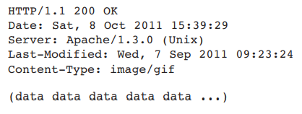
Example
On the behalf of a requesting browser, a proxy cache sends a request message to a Web server:
Web server sends a response message with the requested object to the cache:
Cache forwards the object to the requesting browser but also caches the object locally

Slide 42

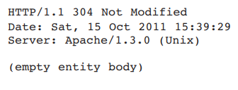
Example(continue)
Cache also stores the last-modified date along with the object
one week later, another browser requests the same object via the cache, and the object is still in the cache
cache performs an up-to-date check by issuing a conditional GET to the server
The cache sends:
Web server still sends a response message but does not include the requested object in the response message (no bandwidth wastage)
Web server sends a response message to the cache:

Slide 43
Electronic Mail - Introduction
One of the internet’s most important and utilized application
E-mail is an asynchronous communication
  People send and read messages when it is convenient for them
In contrast to postal mail,
  Email is fast, easy to distribute and inexpensive
Many powerful features
  Messages with attachments
  Hyperlinks
  Embedded photos etc.

Slide 44
Electronic mail
outgoing
message queue
user mailbox
Three major components:
user agents
mail servers
simple mail transfer protocol: SMTP
User Agent
a.k.a. “mail reader”
composing, editing, reading mail messages
e.g., Outlook, Thunderbird, iPhone mail client
outgoing, incoming messages stored on server
user
agent
mail
server
user
agent
SMTP
mail
server
user
agent
SMTP
SMTP
user
agent
mail
server
user
agent
user
agent

Slide 45
Electronic mail: mail servers
mail servers:
mailbox contains incoming messages for user
message queue of outgoing (to be sent) mail messages
SMTP protocol between mail servers to send email messages
  client: sending mail server
  server: receiving mail server
user
agent
mail
server
user
agent
SMTP
mail
server
user
agent
SMTP
SMTP
user
agent
mail
server
user
agent
user
agent

Slide 46
Electronic Mail: SMTP [RFC 2821]
uses TCP to reliably transfer email message from client to server, port 25
direct transfer: sending server to receiving server (no intermediate servers)
three phases of transfer
  handshaking (greeting)
  transfer of messages
  closure
command/response interaction (like HTTP, FTP)
  commands: ASCII text
  response: status code and phrase

Slide 47


Scenario: Alice sends message to Bob
1) Alice uses UA to compose message “to” bob@someschool.edu
2) Alice’s UA sends message to her mail server; message placed in message queue
3) client side of SMTP opens TCP connection with Bob’s mail server
4) SMTP client sends Alice’s message over the TCP connection
5) Bob’s mail server places the message in Bob’s mailbox
6) Bob invokes his user agent to read message
user
agent
mail
server
user
agent
1
mail
server
2
3
6
4
Alice’s mail server
5
Bob’s mail server

Slide 48
Sample SMTP interaction
S: 220 hamburger.edu
C: HELO crepes.fr
S: 250 Hello crepes.fr, pleased to meet you
C: MAIL FROM: <alice@crepes.fr>
S: 250 alice@crepes.fr... Sender ok
C: RCPT TO: <bob@hamburger.edu>
S: 250 bob@hamburger.edu ... Recipient ok
C: DATA
S: 354 Enter mail, end with "." on a line by itself
C: Do you like ketchup?
C: How about pickles?
C: .
S: 250 Message accepted for delivery
C: QUIT
S: 221 hamburger.edu closing connection
Hostname of client - crepes.fr
Hostname of server – hamburger.edu
C: lines client send into the TCP socket
S: lines server sends into the TCP socket
TCP connection is established and communication is started

Slide 49
SMTP
SMTP uses persistent connections
SMTP requires message (header & body) to be in 7-bit ASCII
SMTP server uses CRLF.CRLF to determine end of message
comparison with HTTP:
HTTP: pull
SMTP: push
both have ASCII command/response interaction, status codes
HTTP: each object encapsulated in its own response msg
SMTP: multiple objects sent in one message

Slide 50
Mail message format
SMTP: protocol for exchanging email messages
RFC 822: standard for text message format:
header lines, e.g.,
  To:
  From:
  Subject:
  different from SMTP MAIL FROM, RCPT TO: commands!
Body: the“message”
  ASCII characters only
header
blank
line
body

Slide 51
Mail access protocols
user
agent
mail access
protocol
user
agent
SMTP
SMTP
(e.g., POP,
IMAP)
sender’s mail
server
receiver’s mail
server
Bob’s UA can’t use SMTP to obtain the messages because obtaining is a pull operation
For transferring mails from Bob’s mail server to his local PC
  Post Office Protocol (POP3)
  Internet Mail Access Protocols (IMAP)
SMTP: delivery/storage to receiver’s server
mail access protocol: retrieval from server
  POP: Post Office Protocol [RFC 1939]: authorization, download
  IMAP: Internet Mail Access Protocol [RFC 1730]: more features, including manipulation of stored msgs on server
  HTTP: gmail, Hotmail, Yahoo! Mail, etc.

Slide 52
POP3 protocol
S: +OK POP3 server ready
C: user bob
S: +OK
C: pass hungry
S: +OK user successfully logged on
authorization phase
client commands:
  user: declare username
  pass: password
server responses
  +OK
  -ERR
transaction phase, client:
list: list message numbers
retr: retrieve message by number
dele: delete
quit
C: list
S: 1 498
S: 2 912
S: .
C: retr 1
S: <message 1 contents>
S: .
C: dele 1
C: retr 2
S: <message 1 contents>
S: .
C: dele 2
C: quit
S: +OK POP3 server signing off

Slide 53
POP3 (more) and IMAP
more about POP3
previous example uses POP3 “download and delete” mode
  Bob cannot re-read e-mail if he changes client
POP3 “download-and-keep”: copies of messages on different clients
POP3 is stateless across sessions
IMAP (RFC 3501)
keeps all messages in one place: at server
allows user to organize messages in folders
keeps user state across sessions:
  names of folders and mappings between message IDs and folder name

Slide 54
Web-Based E-mail
Users today are sending and accessing their mails using Web browsers
Hotmail introduced Web-based access in the mid 1990s
UA is an ordinary Web browser
User communicates with its remote mailboxes via HTTP
E-mail is sent from Bob’s mail server → browser using HTTP rather than POP3 or IMAP
Email is sent from Alice’s browser → mail server using HTTP rather than SMTP
Alice’s mail server still sends and receives messages from other servers using SMTP

Slide 55
DNS: Domain Name System
Humans can be identified in many ways:
  Social Security Number, name, passport, driver license etc
Internet hosts can be identified too
  One identifier for a host is a hostname
    cnn.com, www.yahoo.com etc
Hostnames consists of alphanumeric characters, which is difficult to process by routers
  IP address (32 bit) - used for addressing datagram

Slide 56
DNS: Domain Name System
Q: How to map between IP address and name, and vice versa ?
Domain Name System:
distributed database implemented in hierarchy of DNS servers
application-layer protocol that allows host to query the distributed database
  DNS protocol runs over UDP and
  Uses port number 53

Slide 57
Services provided by DNS
DNS is employed by application layer protocols like HTTP, SMTP and FTP
  To translate hostnames to IP addresses
Procedure:
The same user machine runs the client side of the DNS application.
The browser extracts the hostname, www.someschool.edu, from the URL and passes the hostname to the client side of the DNS application.
The DNS client sends a query containing the hostname to a DNS server.
The DNS client eventually receives a reply, which includes the IP address for the hostname.
Once the browser receives the IP address from DNS, it can initiate a TCP connection to the HTTP server process located at port 80 at that IP address.

Slide 58
Services provided by DNS
DNS services
hostname to IP address translation
host aliasing
  canonical, alias names
mail server aliasing
load distribution
  replicated Web servers: many IP addresses correspond to one name
why not centralize DNS?
single point of failure
traffic volume
distant centralized database
maintenance

Slide 59
DNS: a distributed, hierarchical database
Root DNS Servers
…
…
com DNS servers
org DNS servers
edu DNS servers
yahoo.com
DNS servers
pbs.org
DNS servers
poly.edu
DNS servers
umass.edu
DNS servers
amazon.com
DNS servers
client wants IP for www.amazon.com; 1st approx:
client queries root server to find com DNS server
client queries .com DNS server to get amazon.com DNS server
client queries amazon.com DNS server to get IP address for www.amazon.com

Slide 60

DNS: root name servers
contacted by local name server that can not resolve name
root name server:
  contacts authoritative name server if name mapping not known
  gets mapping
  returns mapping to local name server
c. Cogent, Herndon, VA (5 other sites)
d. U Maryland College Park, MD
h. ARL Aberdeen, MD
j. Verisign, Dulles VA (69 other sites )
k. RIPE London (17 other sites)
i. Netnod, Stockholm (37 other sites)
e. NASA Mt View, CA
f. Internet Software C.
Palo Alto, CA (and 48 other sites)
m. WIDE Tokyo
(5 other sites)
13 root name “servers” worldwide
a. Verisign, Los Angeles CA
(5 other sites)
b. USC-ISI Marina del Rey, CA
l. ICANN Los Angeles, CA
(41 other sites)
g. US DoD Columbus, OH (5 other sites)

Slide 61
TLD, authoritative servers
top-level domain (TLD) servers:
  responsible for com, org, net, edu, aero, jobs, museums, and all top-level country domains, e.g.: uk, fr, ca, jp
  Network Solutions maintains servers for .com TLD
  Educause for .edu TLD
authoritative DNS servers:
  organization’s own DNS server(s), providing authoritative hostname to IP mappings for organization’s named hosts
  can be maintained by organization or service provider

Slide 62
Local DNS name server
does not strictly belong to hierarchy
each ISP (residential ISP, company, university) has one
  also called “default name server”
when host makes DNS query, query is sent to its local DNS server
  has local cache of recent name-to-address translation pairs (but may be out of date!)
  acts as proxy, forwards query into hierarchy

Slide 63
DNS name resolution example
root DNS server
2
host at cis.poly.edu wants IP address for gaia.cs.umass.edu
3
TLD DNS server
4
5
iterated query:
contacted server replies with name of server to contact
“I don’t know this name, but ask this server”
local DNS server
dns.poly.edu
7
6
1
8
authoritative DNS server
dns.umass.edu
requesting host
cis.poly.edu
gaia.cs.umass.edu

Slide 64
DNS name
resolution example
root DNS server
2
3
recursive query:
puts burden of name resolution on contacted name server
heavy load at upper levels of hierarchy?
7
6
TLD DNS
server
local DNS server
dns.poly.edu
5
4
1
8
authoritative DNS server
dns.cs.umass.edu
requesting host
cis.poly.edu
gaia.cs.umass.edu

Slide 65
DNS: caching, updating records
once (any) name server learns mapping, it caches mapping
  cache entries timeout (disappear) after some time (TTL)
  TLD servers typically cached in local name servers
    thus, root name servers not often visited
cached entries may be out-of-date (best effort name-to-address translation!)
  if name host changes IP address, may not be known Internet-wide until all TTLs expire
update/notify mechanisms proposed IETF standard
  RFC 2136

Slide 66
DNS records
DNS: distributed db storing resource records (RR)
RR format: (name, value, type, TTL)
type=A
  name is hostname
  value is IP address
type=CNAME
  name is alias name for some “canonical” (the real) name
  www.ibm.com is really
  servereast.backup2.ibm.com
  value is canonical name
type=NS
  name is domain (e.g., foo.com)
  value is hostname of authoritative name server for this domain
type=MX
  value is name of mailserver associated with name

Slide 67
DNS protocol, messages
query and reply messages, both with same message format
2 bytes
2 bytes
msg header
identification: 16 bit # for query, reply to query uses same #
flags:
  query or reply
  recursion desired
  recursion available
  reply is authoritative
identification
flags
# questions
# answer RRs
# authority RRs
# additional RRs
questions (variable # of questions)
answers (variable # of RRs)
authority (variable # of RRs)
additional info (variable # of RRs)

Slide 68
DNS protocol, messages
2 bytes
2 bytes
identification
flags
# questions
# answer RRs
# authority RRs
# additional RRs
name, type fields
for a query
questions (variable # of questions)
RRs in response
to query
answers (variable # of RRs)
records for
authoritative servers
authority (variable # of RRs)
additional “helpful”
info that may be used
additional info (variable # of RRs)

Slide 69
Inserting records into DNS
example: new startup “Network Utopia”
register name networkuptopia.com at DNS registrar (e.g., Network Solutions)
  provide names, IP addresses of authoritative name server (primary and secondary)
  registrar inserts two RRs into .com TLD server:
  (networkutopia.com, dns1.networkutopia.com, NS)
  (dns1.networkutopia.com, 212.212.212.1, A)
create authoritative server type A record for www.networkuptopia.com; type MX record for networkutopia.com

Slide 70
Attacking DNS
DDoS attacks
Bombard root servers with traffic
  Not successful to date
  Traffic Filtering
  Local DNS servers cache IPs of TLD servers, allowing root server bypass
Bombard TLD servers
  Potentially more dangerous
Redirect attacks
Man-in-middle
  Intercept queries
DNS poisoning
  Send bogus relies to DNS server, which caches
Exploit DNS for DDoS
Send queries with spoofed source address: target IP
Requires amplification

Slide 71


